Slide 1

Mr Butler | A2 Digital Technology

Slide 2


What We’re Looking to Learn
Describe and evaluate methods of detecting and correcting data transmission errors:
  Parity bits,
  Checksums,
  Echo Checking and
  Cyclic redundancy check (CRC);

Slide 3

Parity checks to ensure that a single byte or word of data has been transferred within the system correctly.
A bit in each byte or word is reserved to be the par­ity bit.
  This parity bit is set to 1 or to O depending on the data.
  If the data is corrupted then the parity check is likely to fail.
Parity Bits

Slide 4
How Parity Bits Work
Let’s consider sending the word FOG…
Character | ASCII | EVEN Parity | ODD Parity
F | _100 0110 | 1100 0110 | 0100 0110
O | _100 1111 | 1100 1111 | 0100 1111
G | _100 0111 | 0100 0111 | 1100 0111
A specific bit in a byte is the parity bit. This is the 8th bit in the byte, often termed the most significant bit.
When using odd parity, the sum of the bits in the sequence should be odd, and if even parity is used, the sum of the bits should be even if the data has been received correctly.
If the parity of the byte has changed, then it can be considered that there has been an error in transmission and at least one bit has been flipped/received in error.
And we’re using EVEN Parity…
Character Sent | ASCII Code Received | Character Received
F | 1100 0100 | D | This byte has an odd number of 1’s, so we know there is an error here
O | 1100 1111 | O
G | 0100 0111 | G
At this stage, we can tell there is an error in the first byte sent; however, we cannot tell which bit is in error.
Parity bits are limited, as they can only tell if an odd number of bits have been sent in error.
If an even number of bits in the byte had been corrupted, parity checking would not pick up on it. We need to develop our error checking abilities!
This might be what we receive…

Slide 5
Parity Bit Version 2: Hamming Code
We’ll continue to use even parity in this example
We can use a process called ‘Hamming code’ to be able to actually highlight the error and correct it.
To use this, we need to have a ‘vertical’ and ‘horizontal’ set of parity bits
Using this method with large amounts of data would be considerably slow coupled with the possibility of the parity bits becoming corrupted and leading to error within parity.
1 | 1 | 0 | 0 | 0 | 1 | 0 | 0
1 | 1 | 0 | 0 | 1 | 1 | 1 | 1
0 | 1 | 0 | 0 | 0 | 1 | 1 | 1
 | 1 | 0 | 0 | 1 | 1 | 1 | 0

Slide 6
Checksums
Checksums to ensure that a block of data has been transferred within the system correctly.
Extra words of data are added to a block that are worked out from the value of the data in the block.
  At later stages the checksum is worked out again, and compared with the original, to ensure the data has not been corrupted at some stage in the system.
This check is more complex than the parity check but is more suited to verifying quantities of data larger than single bytes or words.
Packet handler | Destination address | Source address | Packet sequence number | Data | Checksum (CRC)
10101100 | 01100110 | 10010111 | 11010001 | 10001100 | 0001 0100 (checksum)
Data contains a total of 20 1’s
This is added as your checksum to the end of the packet. You’ll notice a packet is made up of several bytes, so is slightly more efficient than a basic parity bit system

Slide 7
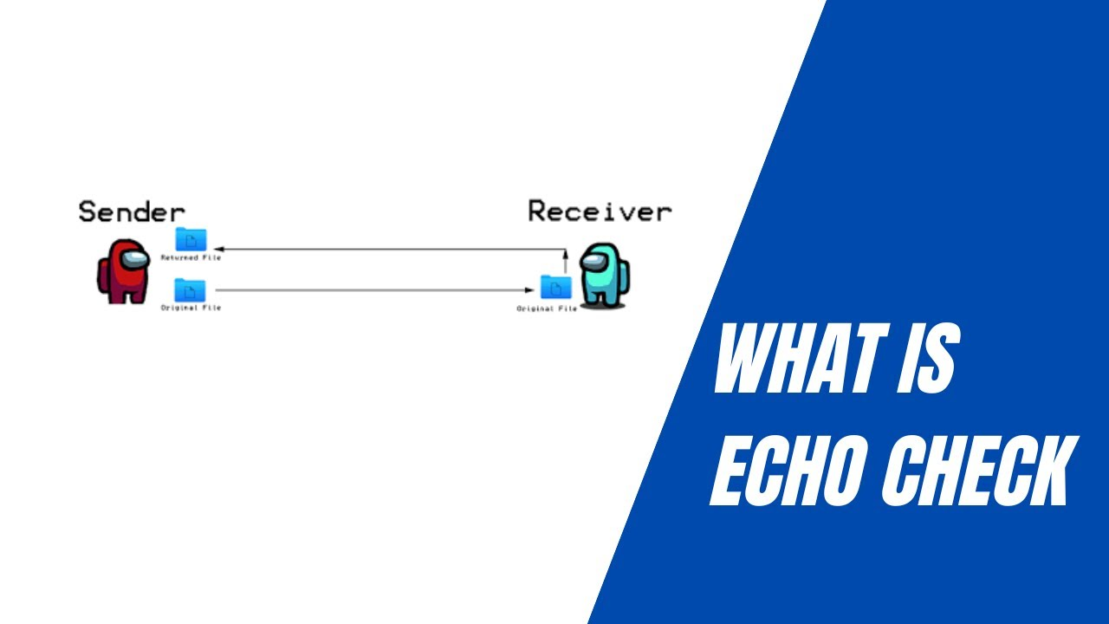

Echo Checking is a feature of data transmission in which the data received is returned to the point of origin for comparison with the original data in order to check it.
When data is received a copy is transmitted back to the source or point of origin where it is compared with the original data. If it differs the original data can be requested to be retransmitted.
Echo checking is an automatic process.
  It is very much like when someone tells you their phone number and you repeat the number back to them to ensure it matches (although, it might not be the right phone number in the first place but that’s something else).

Slide 8


What Are
Cyclic Redundancy Checks (CRC’s)
These are a particular type of checksum.
They are commonly used to verify blocks of data stored on disks or transmitted across networks.
The process involves using an algorithm which is applied to a block or packet of data, creating a checksum.
The checksum is appended to the block, and when this block is received the checksum is recalculated using the same algorithm. If it differs, an error has occurred
Notes:
Link: https://www.youtube.com/watch?v=iwj8ZgyzqZk

